Slide 1
Promoting Positive Risk taking and Protection Principles
Making Safeguarding Personal

Slide 2
Lets think…………………………..
What is risk ?
What is positive risk taking ?
How can we support positive risk taking principles ?

Slide 3
What is risk ?
Risk is the probability that an event will occur with beneficial or harmful outcomes for an individual or others they come into contact with.
Events can occur due to:
Risks associated with impairment or disability such as falls
Risks associated with changes in relationships
Accidents whilst out in the community or using a service
Risk associated with everyday activities which may increase due to impairment or disability
Use of medication
Misuse of alcohol or drugs
Behaviours resulting in injury, neglect, abuse and exploitation by self or others

Slide 4
What is risk cont….
Suicide or self harm
Aggression and violence
The level of risk will be determined by the type of event and the impact of the outcome.
This depends on the person, their relationship with others and the circumstances they find themselves in.
Risk is often thought of in terms of DANGER/LOSS/THREAT or INJURY, however, in addition to potential negative characteristics risk taking can have positive benefits for individuals and their communities
Therefore as well as considering dangers associated with risk we also need to identify any potential benefits to such risk. A process which should involve the individual using services, their families and health or social car staff.

Slide 5
What is Positive Risk taking ?
Positive risk taking is a process which starts with the identification of potential benefit or harm.
The desired outcome is to encourage and support people in positive risk taking to achieve personal change or growth.
In pairs can you identify examples of a positive risk ?

Slide 6
How do we support positive risk taking ?
By assuming that people can make their own decisions and supporting people to do so.
Working in partnership with individuals families and professional and recognising different perspectives and views
Developing an understanding of the responsibilities of each party
Empowering people to access opportunities and take worthwhile chances
Understanding the persons perspective of gains and loss from taking risks or being prevented to do so.
Promoting trusting working relationships
Understanding the consequences of different actions

Slide 7
Ensuring information available is accurate and decisions are mad eon choices available.
Positive approach to risk taking
Knowing what has or not worked in the past
Identifying the persons strengths
Promoting learning from experience
Ensuring support and advocacy are available
Ensuring service promote independence not create dependence
Sometimes supporting short term risk for long term gains.

Slide 8
Underpinning Principles ?
What principles underpin the approach to positive risk taking ?

Slide 9
Understanding the principles – working positively with risk
Risk is an everyday experience
Remember risk is dynamic – therefore assessment and management needs to be dynamic with plans regularly reviewed and updated.
All people including vulnerable adults have the right to take risk- but does not give them the right to place others at risk.
It is not always possible to remove risk but it can often be minimised
Identification of risk carries a responsibility to do something about it !

Slide 10
Principles cont…
Decisions should be based on clear reasoning using principles of multi disciplinary interagency working in proportion to the risk impact to self and others
Good risk management involves working together to achieve positive outcomes for people.
Where risk taking has resulted in negative outcomes for people using services the experience should be learnt from and used to inform future decisions.

Slide 11
Frameworks for Positive Risk Taking
Staff who are supporting people to take risks must follow a structured approach in which the rationale for decisions can be evidenced.
Decision making on the management of risk will be at a level proportionate to the risk impact.
This must include ensuring proper adherence to the legal framework including the Mental Capacity Act 2005.

Slide 12
Capacity Consent and Decision Making
Capacity will be determined in line with the code of conduct and requirements of the Mental Capacity 2005. staring with the assumption of capacity- remember this principle does not and should not stop the assessment of capacity if there is any indication it is required.
An individual who is assessed as having capacity to make decisions and choses to live with that risk is entitled to do so.
The law will not treat that person as having consented to that risk and so there will be no breach of the duty of care by professional or public authorities…………

Slide 13
However….
The council remains accountable for the proper use of its public funds and whilst the capacitated individual is entitled to live with a degree of risk the local authority is under no obligation to fund it.
In complex cases there will need to be a robust process whereby conflict about accountability of risk or otherwise can be properly debated and resolved with appropriate recording.

Slide 14
Making Safeguarding Personal
Making Safeguarding Personal is a shift in culture and practice in response to what we now know about what makes safeguarding more or less effective from the perspective of the person being safeguarded.
It is about having conversations with people about how we might respond in safeguarding situations in a way that enhances involvement, choice and control as well as improving quality of life, wellbeing and safety.
It is about seeing people as experts in their own lives and working alongside them. It is about collecting information about the extent to which this shift has a positive impact on people’s lives. It is a shift from a process supported by conversations to a series of conversations supported by a process.

Slide 15
Examples of the kind of outcomes that people might want are:
• to be and to feel safer
• to maintain a key relationship
• to get new friends
• to have help to recover
• to have access to justice or an apology, or to know that disciplinary or other action has been taken
• to know that this won’t happen to anyone else

Slide 16
Continued……………………
•
to maintain control over the situation
• to be involved in making decisions
• to have exercised choice
• to be able to protect self in the future
• to know where to get help.
This is not an exhaustive list. The following are not outcomes in the sense that we mean it:
• harm or abuse is substantiated/ unsubstantiated
• the person is receiving increased monitoring or care.

Slide 17
MSP and working with risk
MSP means having honest discussions with people about the possible options and the risks and benefits of each option, framed and more focused risk enablement.
The very process of engaging with them often gives them a sense of control and self-esteem that enables them to better safeguard themselves. Staff need a range of knowledge and skills relating to engaging with and empowering people, negotiation and the legal framework in which they work.
Many have this knowledge and skill base and need permission and support to use it. MSAB is committed to supporting the development and embedding of MSP in all of its activities

Slide 18
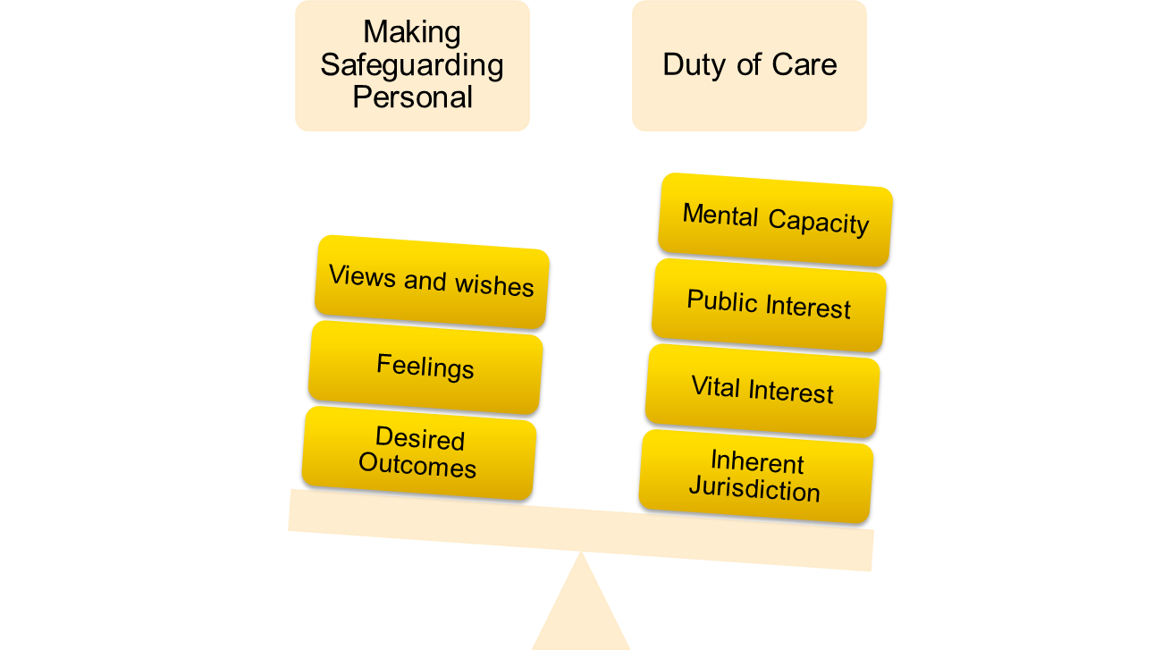
Balancing the Scales

Slide 19
Questions and Answers ?

